Slide 1
Instacart Basket Analysis
Prepared by Meredith Flahan

Slide 2
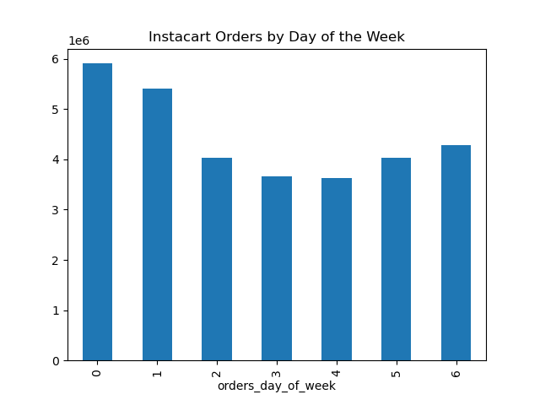
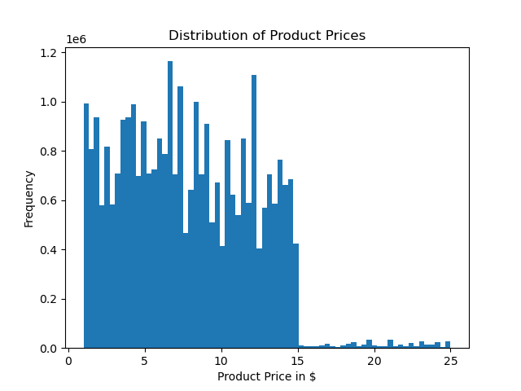
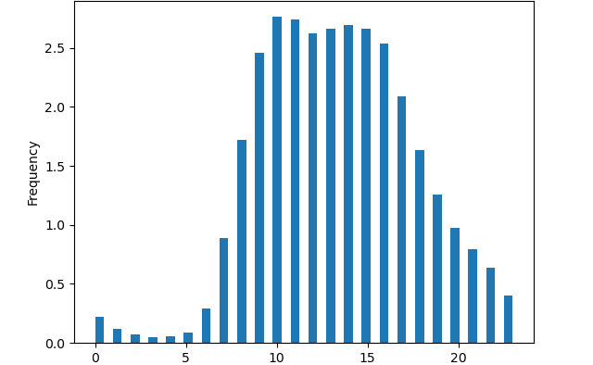
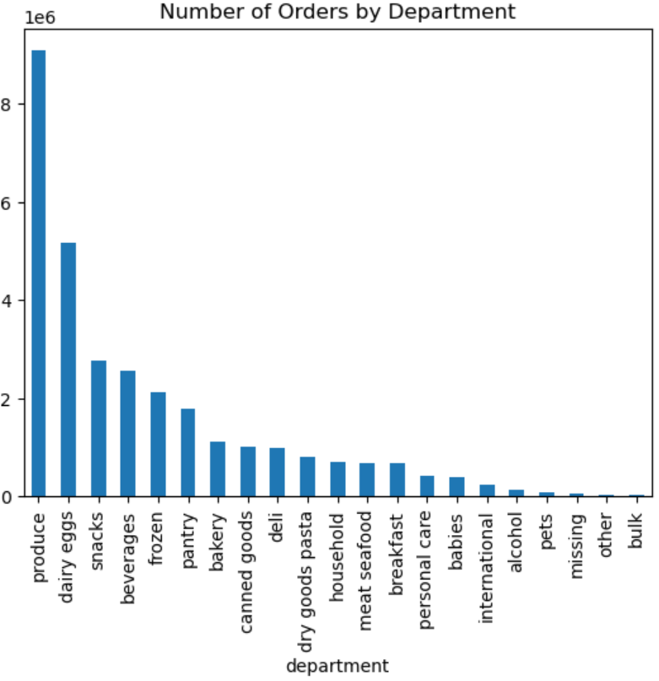
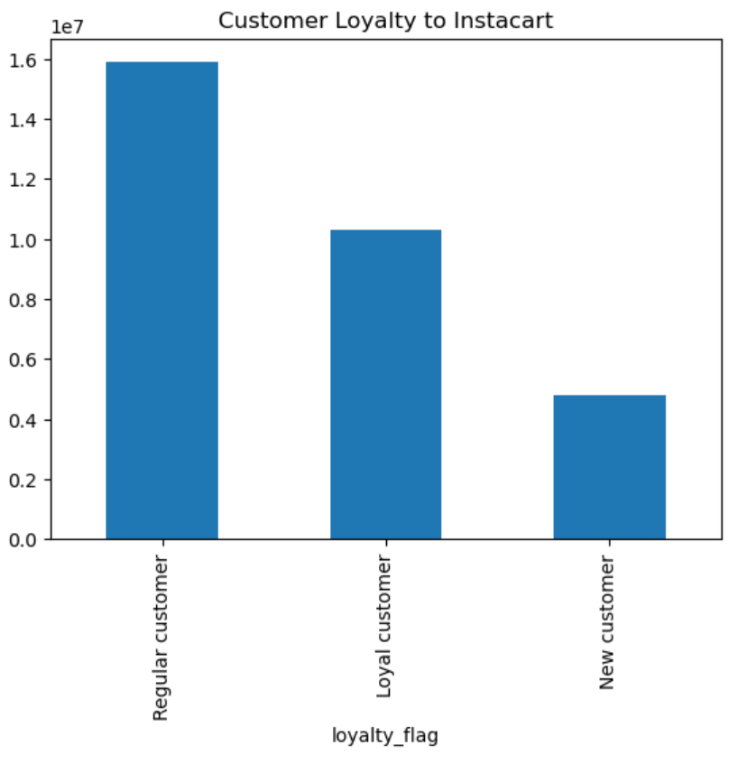
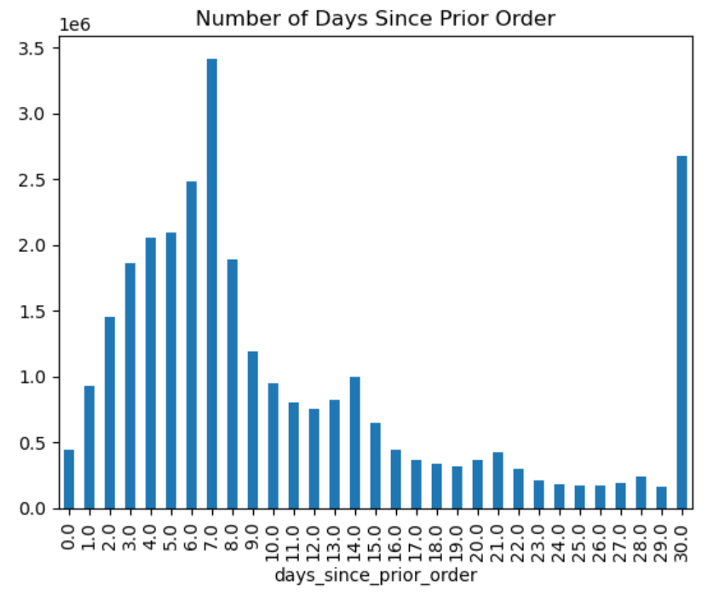
Customer Ordering Behaviors
Instacart Orders by Hour of the Day

Slide 3
Customer Ordering Behaviors
Data Insights
• Busiest days of the week are Saturdays and Sundays.
• Busiest hours of the day are between 9 am and 5 pm with the highest peak between 10 am and 12 pm.
• Customers demonstrate a large preference for items that cost $15 or less.
• Mid-range products between $5 - $15 comprise 67% of orders.
• The top 5 departments for order frequency are produce (29% of all orders) , dairy/eggs, snacks, beverages, and frozen foods.
• 51% of customers are regular customers (<=40 & >10 orders), 33% are loyal customers (>40 orders), and 15% are new customers (<10 orders).
• The largest number of customers are ordering every 8 days. There is another large spike of days between orders at 30 days (The data showing the number of days since a prior order caps at 30 days. Any reorders after 30 days may be included in this category.)
Recommendations
• Time more ads on Friday evenings and Saturday mornings as people are planning their grocery needs for the week.
• Morning ads throughout the week may encourage more afternoon ordering.
• I suggest price groupings of less than $5, $5 up to $15, and $15 and higher.
• Sales drop off significantly past $15, so focused marketing efforts should be on products that fall on the higher end of this mid-range price grouping, or $10 - $15, for highest impact on revenue.
• Knowing that customers mostly want produce and dairy/egg products, the availability of these products should be emphasized in our advertising.
• I recommend targeting advertising to our customers who have waited over 8 days since their last order because the number of reorders drops quickly at that point.
• We should consider advertising loyalty incentives to those who are regularly ordering once a week, such as reward points, discounts, and coupons.

Slide 4
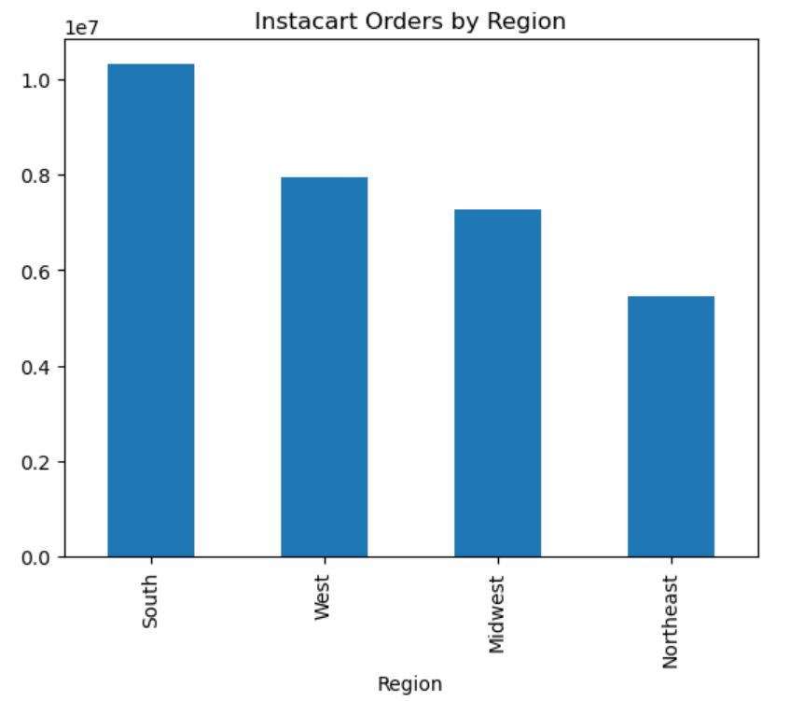
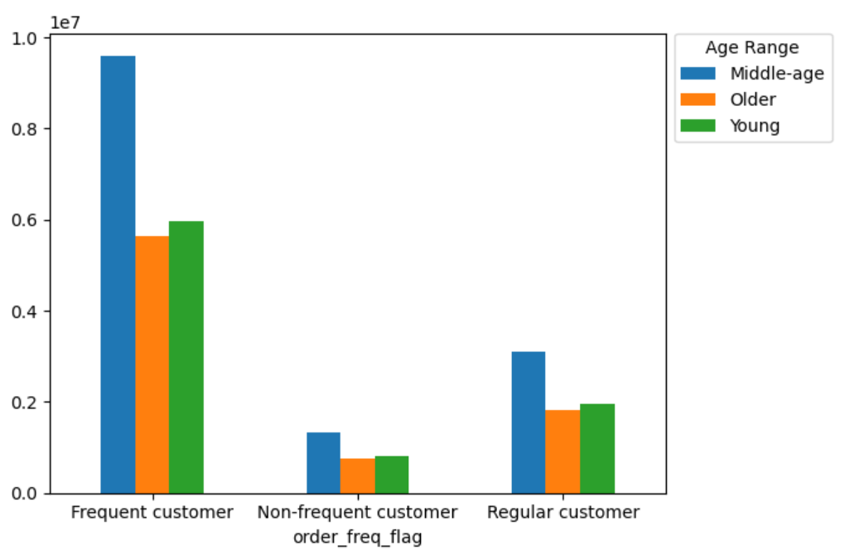
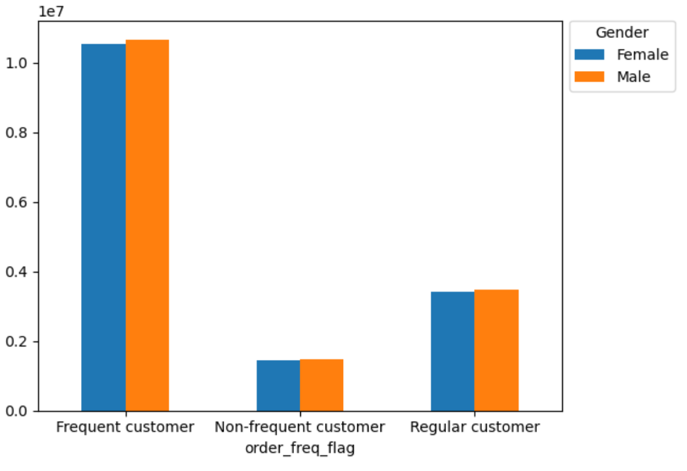
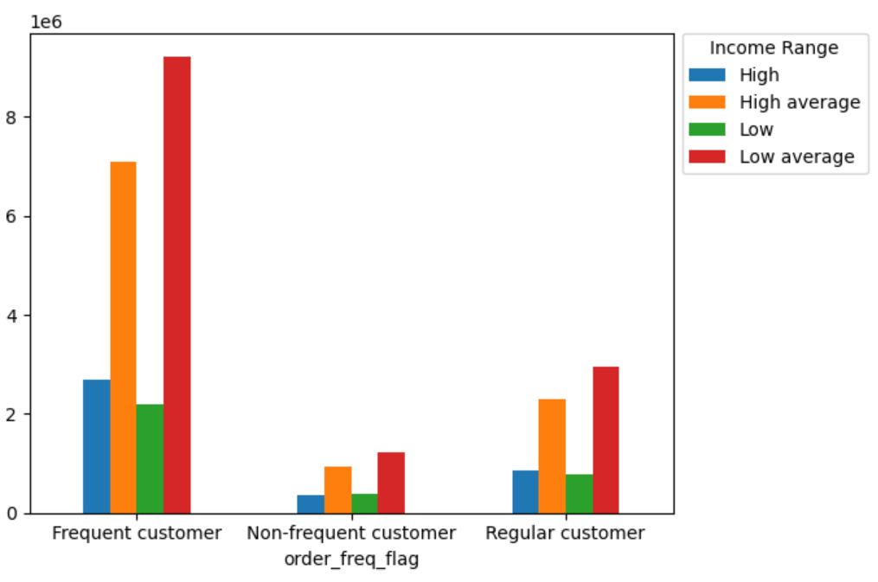
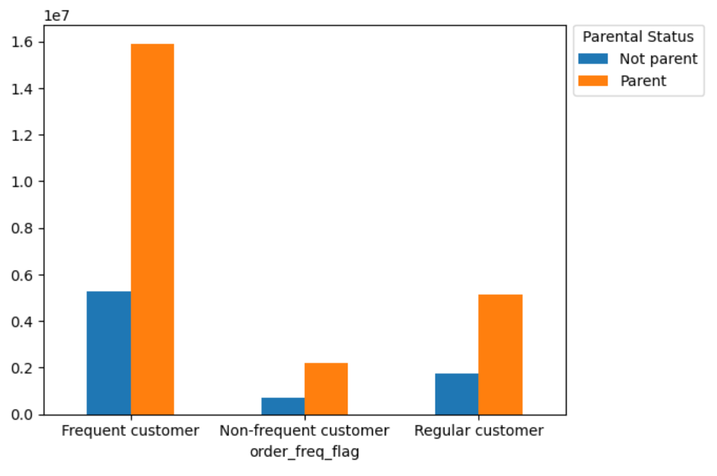
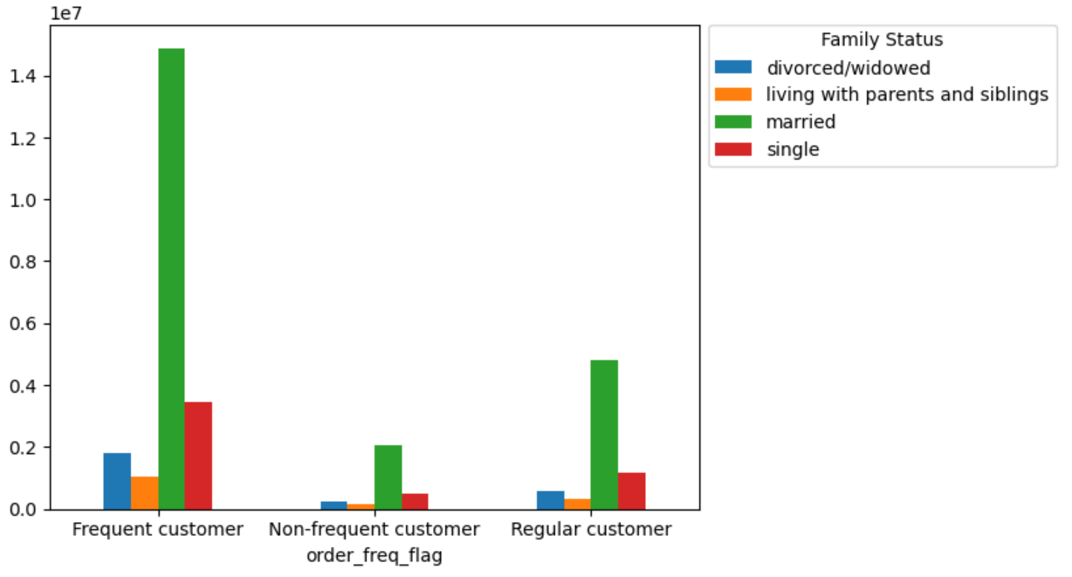
Customer Demographics
Instacart Orders by Gender
Instacart Orders by Age
Instacart Orders by Income
Instacart Orders by Parental Status
Instacart Orders by Family Status

Slide 5
Customer Demographics
Data Insights
• Analysis focused on order frequency because this has the largest impact on Instacart revenue since average amount spent on orders is steady.
• Most customers are located within the south since it is the most populous region included in this analysis.
• Parents place ~300% more orders than non-parents in all departments.
• Middle-aged people place ~170% more orders than older people and ~160% more than younger people.
• A low-average income ($50,000 - $100,000) is the highest represented income level followed by high-average ($100,000 - $150,000).
• Gender is not a significant classification factor.
Recommendations
• Parents, middle-aged, people, and married people are highly represented in all analyses of ordering habits, though this does not mean that ordering habits are directly influenced by age, parental status, and family status. The distribution of these classifications are comparable against department orders, order frequency, and spending habits, suggesting that they do not have a causal relationship.
• It is valuable to know the demographics of the customers to appeal to the lifestyles that apply to the majority of customers.
• I recommend further analysis into other factors that may impact on ordering habits, as they may not have been covered here. Perhaps those working outside of the home vs those who do not or rural vs urban living play a role.
• I recommend further investigation with customer surveys on why they order through Instacart.
• Overall, from this analysis, marketing efforts should focus on parents, middle-aged people, those with low-averages incomes, and married people since they make up the majority of the customer base.

